Slide 1
Employee Data Analysis using Excel
STUDENT NAME: R. Sneha
REGISTER NO: 312212872 / unm14512022g122
DEPARTMENT: Bcom General
COLLEGE: Mahalashmi Women's College of Arts and Science

Slide 2
PROJECT TITLE
Employee Performance Analysis using Excel

Slide 3


AGENDA
Problem Statement
Project Overview
End Users
Our Solution and Proposition
Dataset Description
Modelling Approach
Results and Discussion
Conclusion
3/21/2024 Annual Review

Slide 4

PROBLEM STATEMENT > Employee performance analysis is made to identify the performance level of an employee in each department. > It helps to track the activities and growth of the employees in wholly by department wise. > And it helps to grant remuneration or appreciation for the respected one.

Slide 5

PROJECT OVERVIEW Objective: Analyze employee performance across different zones. Data Breakdown: The spreadsheet contains performance data categorized by zones (Zone A, Zone B, Zone C). Visual Insights: The bar chart helps in quickly identifying high and low-performing zones. Zone A, Zone B, and Zone C have varying performance levels, as indicated by the heights of the bars.

Slide 6

WHO ARE THE END USERS? The end users are individuals who directly interact with this information. They use it for analysis, decision-making, or reporting purposes. These end users may include business analysts, managers, or other stakeholders who rely on the data to inform their actions and strategies.

Slide 7

OUR SOLUTION AND ITS VALUE PROPOSITION Conditional Formatting – missing Filter – remove Formula – performance Pivot – summary Graph – data visualization

Slide 8
Dataset Description Employee – Kaggle 26 – features 9 – features Emp id-num Name-text Emp type Performance level Gender- male female Emplyee rating - num

Slide 9

THE "WOW" IN OUR SOLUTION Performance level = IFS(Z8>=5,”VERY HIGH”Z8>=4,”HIGH”Z8>=3,”MED”,TRUE,”LOW”)
3/21/2024 Annual Review
9

Slide 10
MODELLING
DATA COLLECTION
Download the data from edunet student’s dashboard.
FEATURE COLLECTION
Highlighted data which is required using the fill option.
DATA CLEANING
Identifies the missing values using conditional formatting.
Removed/filtered the missing data using filter-filter by colour.
PERFORMANCE LEVEL
Performance analysis is based on Department type is filtered by gender.(Male employees).
10

Slide 11
SUMMARY
Pivot table is created to summarise the data.
Row Labels- it is considered as department type.
Column labels- described the performance level.
Filter- By gender where I preferred the male employees in this data.
Values- To make a count used first name for count of employees in each field.
VISUALIZATION
Used the graph chart to analyze the employees(in units)in the department
type category.
Used the bar graph to analyze the employees overall percentage in the
department type category.

Slide 12
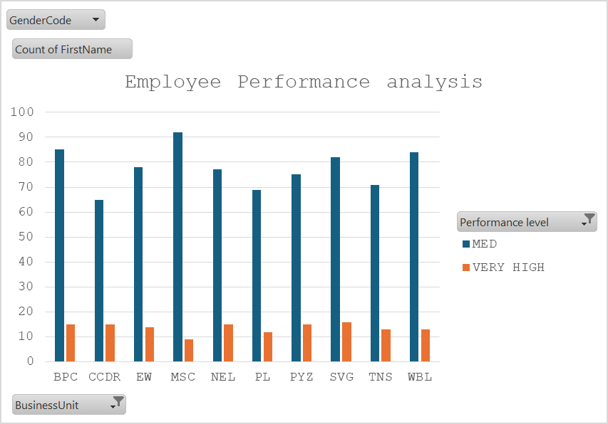
RESULTS
12

Slide 13
Conclusion Business Units: The x-axis represents different business units, including BPC, CDR, EIM, ESC, MCI, NEL, PLZ, SVG, TNS, and WBI. Performance Levels: The y-axis shows a count of first names, ranging from 0 to 100. There are three performance levels: MED (Medium) HIGH VERY HIGH Observations: Each business unit has varying counts of first names across these performance levels. The chart provides a visual comparison of performance levels among the units.

